Slide 1


Microservices Architecture
Prepared and Presented
By Team #1
Afnan Sayed Jana Abdallah Afnan Baqais
20226014 20226030 20216049
October 15, 2025

Slide 2
Agenda
1
Concept & Motivation Behind Microservices Architectutre
2
How Microservices work
3
Integration and Communication Strategies Explored
4
Live Demo of System Functionality
2

Slide 3

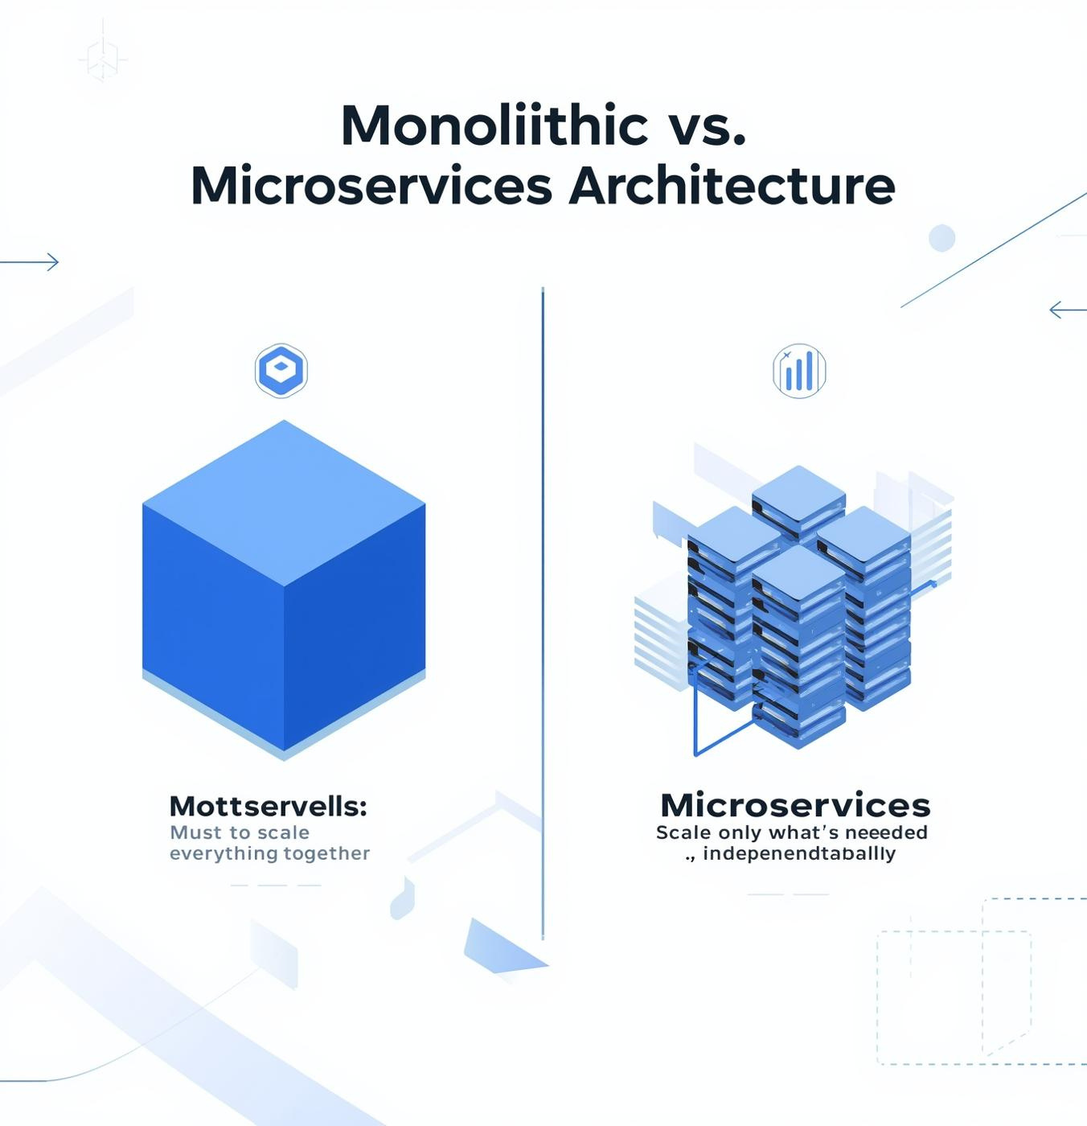
1
Can We Scale Just One Part?
What if one part of the system gets heavy traffic, should we scale the entire app or just that part?
Monolithic
3

Slide 4

1
Fault Isolation
Monolithic: One failure = total downtime
Microservices: Each service runs independently, others keep working
4

Slide 5

1
Technology Freedom
Monolithic Architecture
One technology stack limits innovation.
Microservices Flexibility
Diverse tech stacks boost agility and growth.
5

Slide 6

Importance of Containerization
Key Benefits for Microservices
Isolation of services enhances stability
Portability across various platforms
Scalability with orchestration tools
6

Slide 7


2
How it works?
7

Slide 8
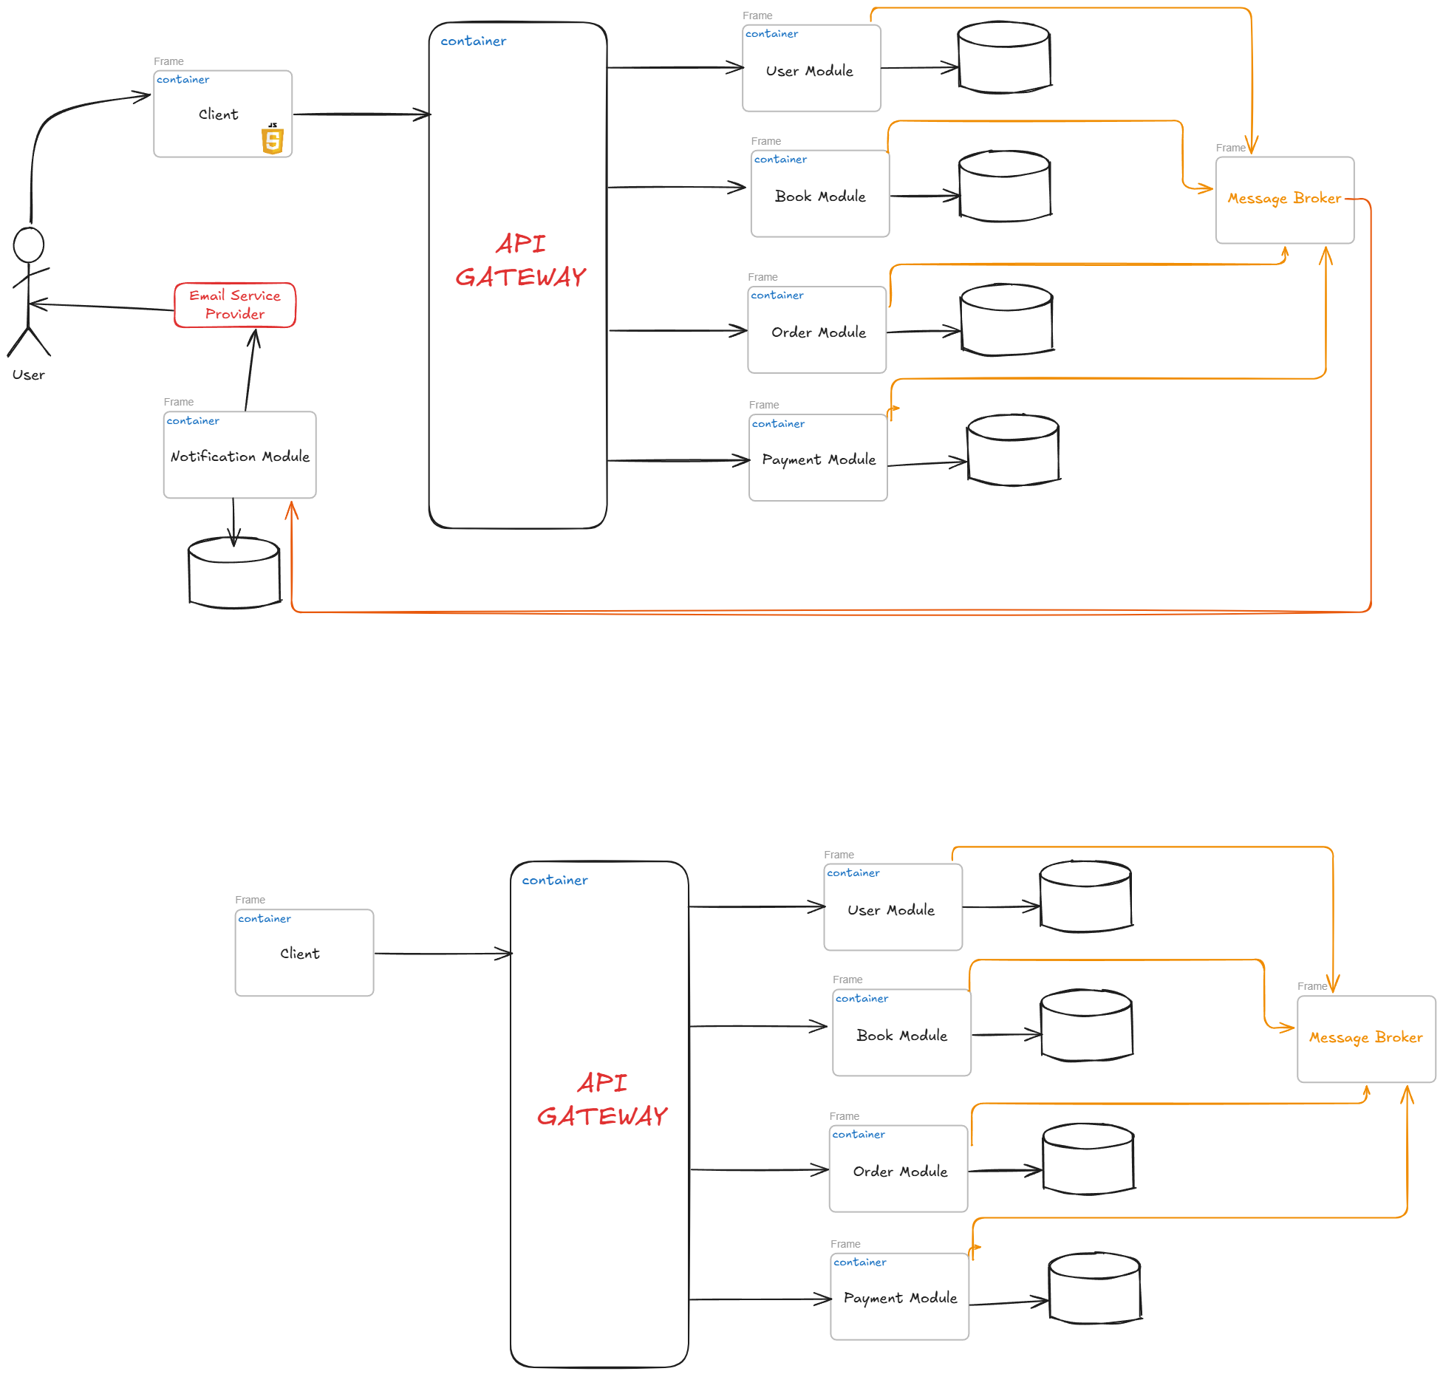
2
How Microservices Work
API
8

Slide 9

3
Integrations and Connections
9

Slide 10
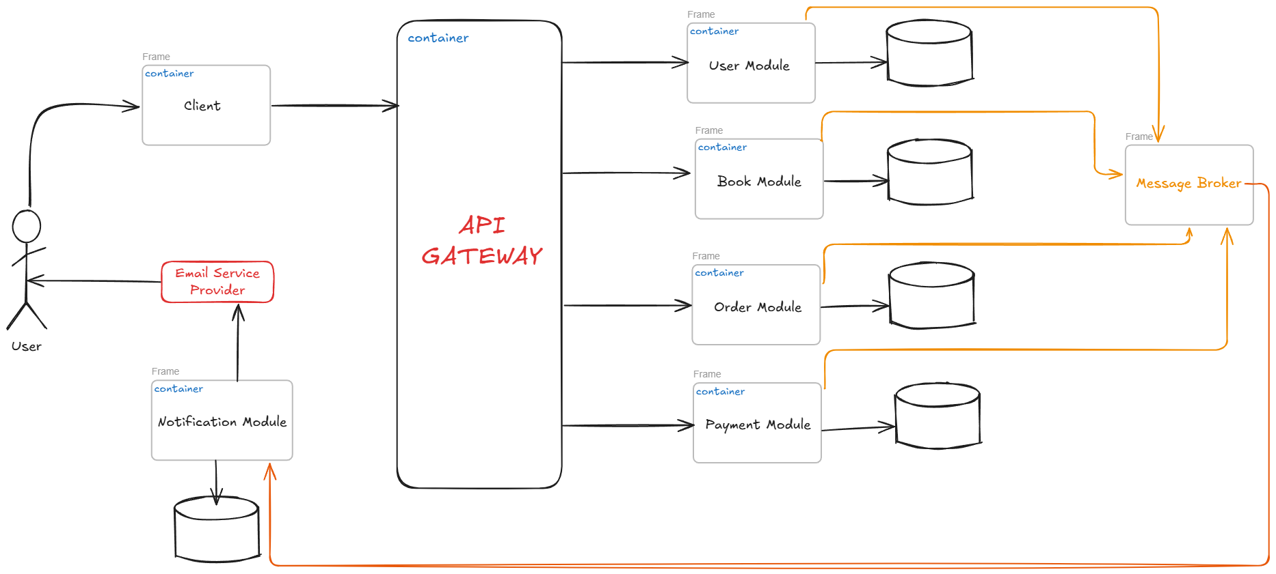









3
System Architecture
API
API
API
API
10

Slide 11
Live Demo
11

